Slide 1
Key Insights Report
Minimize Loan Defaults
High-Risk Customers: Identified high-risk customers based on low credit scores and overdue amounts. Customers with credit scores below 600 and overdue amounts above zero are considered high-risk.
Regional Insights: Overdue loans are more prevalent in certain regions. Specific regions have higher default rates due to customer income levels and loan amounts.

Slide 2
Minimize Loan Defaults -Key Insights
Customer Behavior: Customers with a credit score below 600 or high overdue amounts are at a higher risk of defaulting on loans.
Geographical Trends: Regions with lower average income tend to have a higher incidence of overdue loans, indicating that income is a strong predictor of loan defaults.

Slide 3
Recommendations for Minimizing Defaults
Tighter Lending Criteria: Set higher thresholds for credit scores and loan amounts to ensure that customers with lower repayment capacity are filtered out early.
Proactive Monitoring: Implement an early warning system for overdue loans, allowing for early intervention with customers to avoid defaults.
Regional Customization: Customize lending policies by region. In regions with higher default rates, increase collateral requirements or reduce loan amounts.

Slide 4
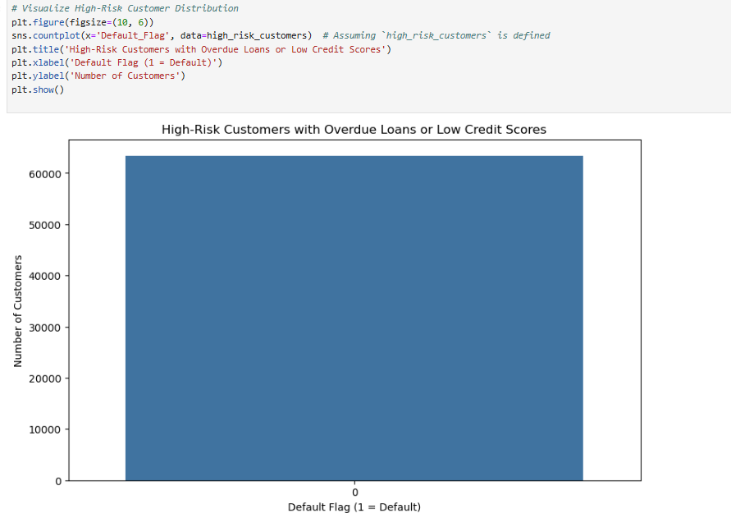
Visualization

Slide 5
Optimize Branch Operations
Key Metrics:
Processing Time: Calculated the average loan processing time for each branch. Identified branches with longer processing times which indicate operational inefficiencies.
Recovery Rates: Analyzed recovery rates across branches. Branches with higher overdue loans need improvements in their recovery strategies.

Slide 6
Optimize Branch Operations – Key Insights
Branch Efficiency: Some branches have much higher processing times than others, signaling that the loan approval process can be automated to speed up approvals.
Recovery Rate Performance: Branches with poor recovery rates should improve their collections process to enhance overall efficiency.

Slide 7
Recommendations for Optimizing Branch Operations:
Automated Approval Process: Implement automation tools for document verification and risk assessment to reduce the time taken to process loans.
Recovery Strategy Improvement: Train staff on effective recovery techniques, use advanced collection systems, and explore outsourcing collections to improve recovery rates in underperforming branches.
Branch Performance Monitoring: Implement continuous branch performance tracking and real-time alerts for processing delays and recovery issues to ensure timely interventions.

Slide 8
Enhance Profitability
Customer Segmentation: Segmented customers based on income, credit score, and repayment behavior. Identified high-value customers as those who have a good credit score and consistent repayment history.
Profitability by Loan Type: Analyzed profitability metrics for each loan type (e.g., home loans, personal loans). Found that home loans generate the most interest income, but personal loans have higher interest rates.

Slide 9
Enhance Profitability - Key Insights
High-Value Customers: High-value customers are those who consistently repay on time and have a higher income. These customers should be targeted for premium loan products.
Loan Type Profitability: Home loans are the most profitable in terms of total interest income, but personal loans can generate more short-term profit due to higher interest rates.

Slide 10
Recommendations for Enhancing Profitability
Target High-Value Customers: Focus on premium products for high-value customers and offer them personalized interest rates to ensure profitability while retaining them.
Adjust Interest Rates: For loan types that generate higher profits (e.g., personal loans), consider adjusting interest rates to maximize returns while maintaining competitive advantage.
Cross-Selling Products: Encourage customers to take bundled products (e.g., loan + insurance) to increase revenue per customer.

Slide 11
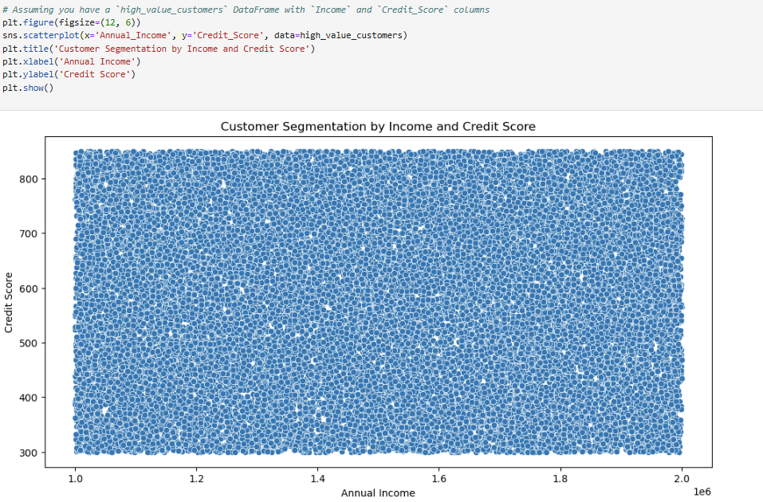
Visualization

Slide 12
Summary of Recommendations
Minimize Defaults
Implement stricter credit checks and regional adjustments in lending.
Introduce early warning systems and proactively monitor customers.
Focus on regions with higher default rates and adjust policies accordingly.

Slide 13
Summary of Recommendations
Optimize Branch Operations:
Use automation tools to reduce loan processing time.
Train staff on better recovery techniques and improve collections efficiency.
Implement real-time monitoring for operational inefficiencies.

Slide 14
Summary of Recommendations
Enhance Profitability
Target high-value customers and offer tailored loan products.
Optimize interest rates based on loan type profitability.
Use cross-selling strategies to increase revenue from existing customers.

